Slide 1
Exploring Explainability in Deep Neural Networks Deep learning (cse 676)
Date: 05-05-2024
Team 47
Kusha Kumar Dharavath
Kishan Nagaraja
Dharma Acha

Slide 2
Project Description
In this project, we address the challenge of the VGG model's complexity in image recognition, which often acts as a "black box" with opaque decision-making processes. This opacity is particularly problematic in sensitive areas like healthcare and autonomous driving, where understanding AI decisions is critical. Our goal is to enhance the transparency and trustworthiness of the VGG model by integrating various explainability techniques, making its internal workings clear and interpretable to enhance user trust and facilitate broader acceptance.

Slide 3
Background
Deep Learning Challenges
Deep neural networks are pivotal in enhancing image processing and autonomous systems but often operate as "black boxes," lacking the necessary transparency for sensitive applications
Key Explainability Techniques
LIME & SHAP: Offer insights into individual predictions and overall feature importance.
Grad-CAM & Saliency Map: Highlight influential regions and pixels in images to demonstrate where models focus their decision-making.
Integrated Gradients (IG): Provides a detailed decomposition of the contribution of each input feature to the final prediction.

Slide 4
Background
Our Approach and Differentiation
Comprehensive Comparative Analysis
Applies and evaluates a broad range of techniques—LIME, Grad-CAM, Saliency Map, IG, and SHAP—on the VGG model to assess their effectiveness in improving transparency.
Specific Focus on VGG Model
Research tailored to the VGG model, used widely in image recognition, enhancing explainability directly applicable to similar architectures in critical applications like healthcare and autonomous driving.
Methodological Innovations
Adapts and fine-tunes explainability techniques to the specifics of VGG and the CIFAR-10 dataset, ensuring practical relevance and improved model transparency.

Slide 5
Dataset Overview
Type of Data: The CIFAR-10 dataset consists of 60,000 color images, each sized 32x32 pixels, spread across 10 different classes (e.g., animals, vehicles) which makes it ideal for image classification tasks.
Source and Volume
Origin: The dataset is a well-known benchmark in the machine learning community, commonly used to train and evaluate image recognition algorithms.
Volume: Comprises 50,000 training images and 10,000 testing images, providing a substantial volume for robust model training and evaluation.
Link to the dataset: https://www.cs.toronto.edu/~kriz/cifar.html

Slide 6
Dataset Overview
Preprocessing and Preparation
Standardization:
Images were normalized using mean and standard deviation values specific to the dataset to ensure consistent input scaling for the model.
Employed data splitting to segregate training, validation, and testing sets, ensuring proper model validation and testing phases.

Slide 7
VGG Model and Training
Model Architecture:
6 Convolution Layers
3 Fully connected Layers
ReLU Activation Function
Maxpooling, Stride, Padding
Training Results:
Train accuracy: 89.29%
Train loss: 0.32
Validation accuracy: 75.52%
Validation loss: 0.81
Test accuracy: 75%
Test Loss: 0.80

Slide 8
Explanability Techniques Explored
Grad-CAM
Saliency MAP
LIME
Integrated Gradient
SHAP

Slide 9
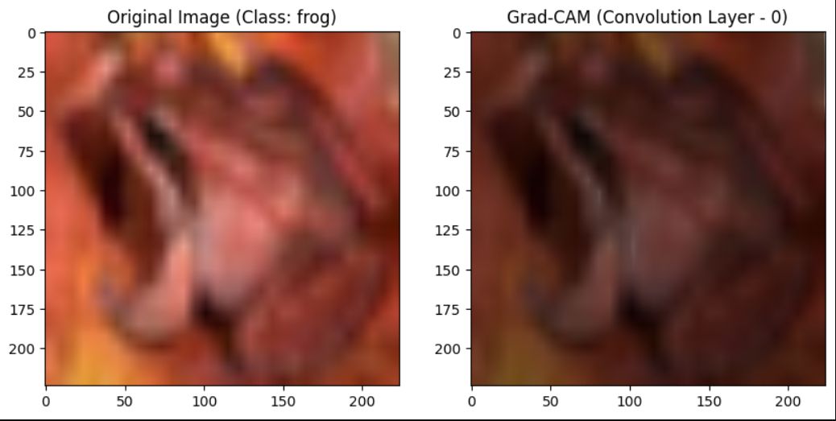
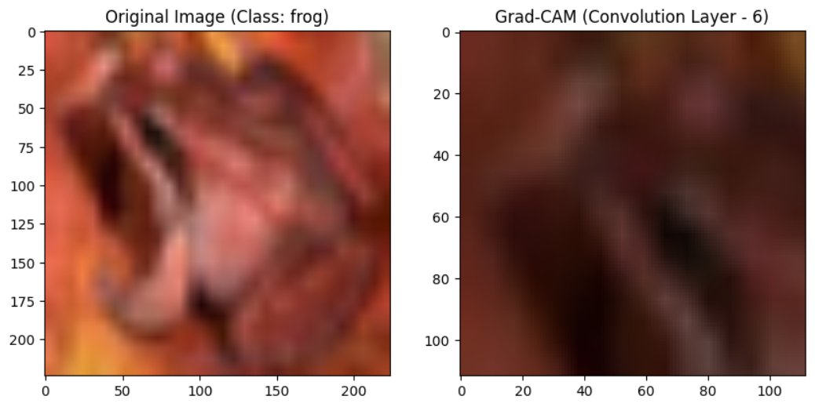
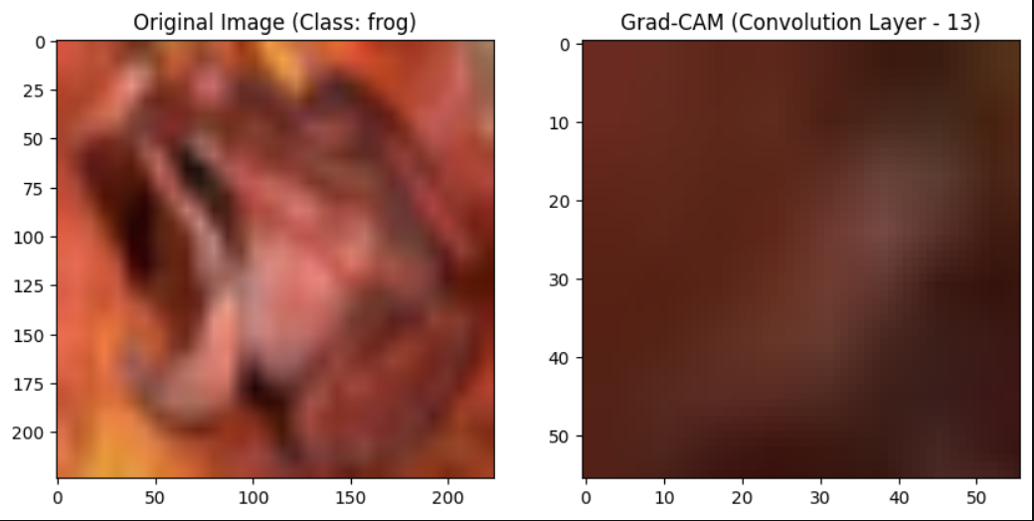
Grad-Cam
The GradCam heatmaps show the regions of the image that are most influential for the VGG13 model when classifying the image as “frog”. We ran the GradCam heatmap for all 16 convolution layers. The images represents the layer-by-layer interpretation

Slide 10
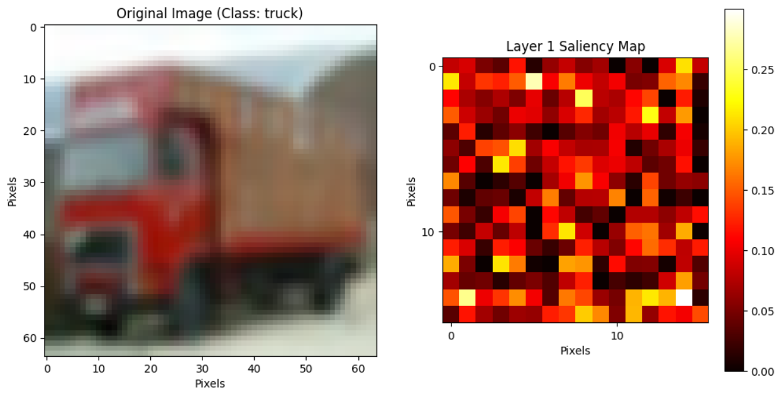
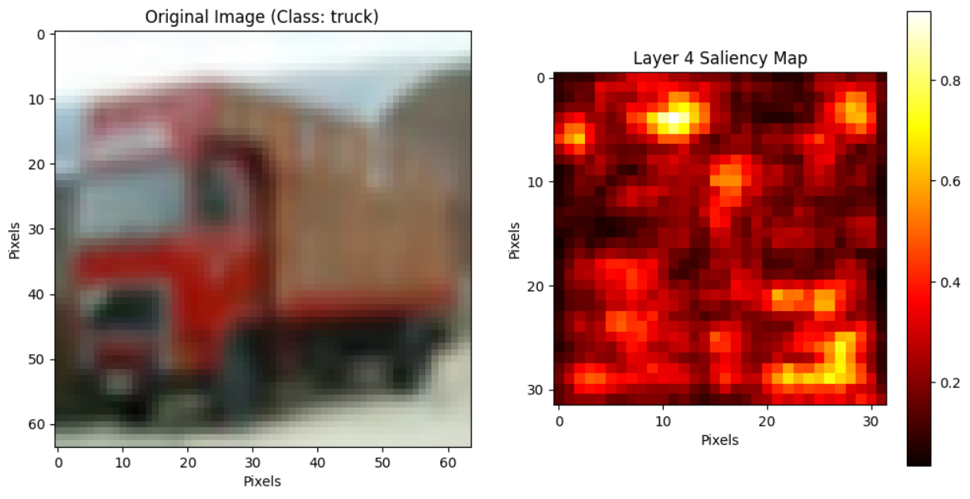

Saliency Maps
To implement saliency maps, we adapted image processing to fit our neural network model's needs, using hooks to monitor activations and gradients. We generated saliency maps to visually highlight key influential areas in images, demonstrating how the model prioritizes features from simple edges to complex patterns across layers, thus exposing its decision-making process.

Slide 11
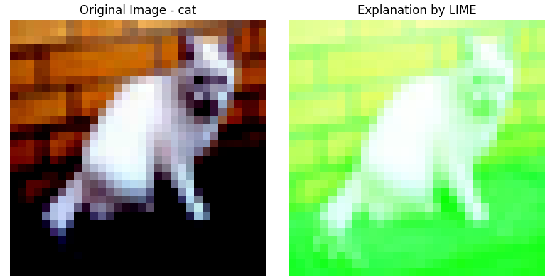
LIME
LIME clarifies how machine learning models make decisions by simplifying a specific decision-making area of the model. It modifies input data slightly and observes the changes in predictions to identify the key features influencing the model’s decisions. This approach is particularly valuable for interpreting complex models like deep neural networks, making it easier to understand what drives their predictions.
Note: neque digni and in aliquet nisl et a umis varius.

Slide 12
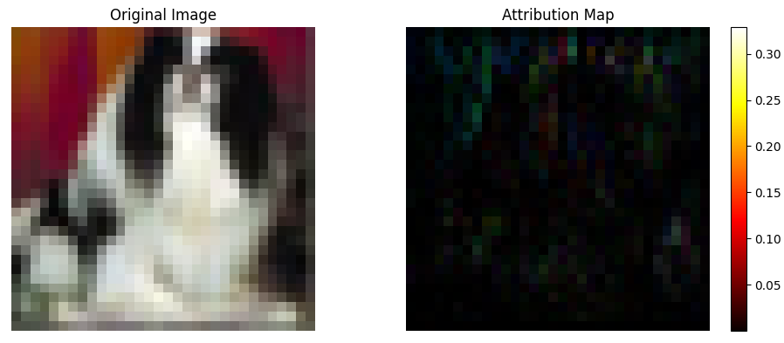
Integrated Gradients
Integrated Gradients (IG) is useful in understanding the contribution of each input feature to the final prediction. This technique is widely used to ensure transparency and reliability in model decisions, especially in sensitive fields.

Slide 13
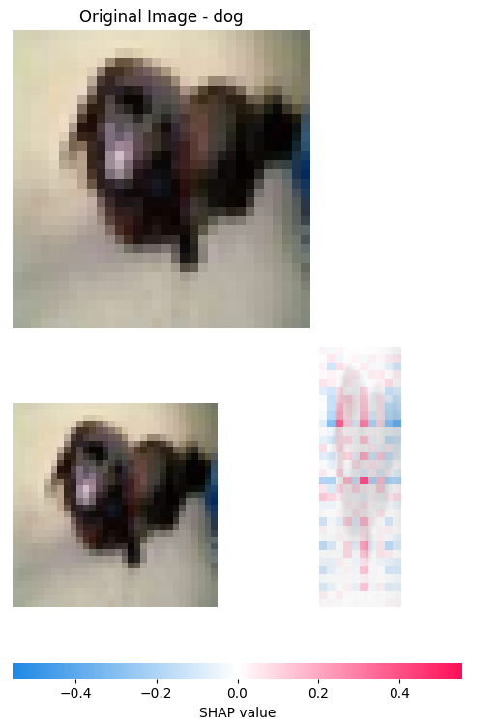
SHAP
SHAP (SHapley Additive exPlanations) is a powerful interpretability technique based on game theory, specifically the Shapley values, which quantify the contribution of each feature to the prediction of a machine learning model. This method is particularly helpful in providing insights into the decision-making process of complex models.

Slide 14
Summary
This project demonstrated how explainability techniques can enhance the trustworthiness of AI models by improving transparency, accountability, fairness, and user trust. By making AI decisions more transparent, these techniques allow users to verify the reasoning behind AI actions, identify and correct errors, comply with regulations, and ensure fairness by detecting biases. Additionally, explainability fosters greater user confidence and facilitates valuable feedback for ongoing model improvement, aligning AI operations more closely with human values and societal norms.

Slide 15
Team Contribution
Kusha Kumar. Dharavath: Model Training, Implemented GradCam Technique and Report
Kishan. Nagaraja: Implemented Saliency Map, LIME and Report
Dharma. Acha: Implemented Integrated Gradient, SHAP and Presentation

Slide 16
Thank you

